Slide 1
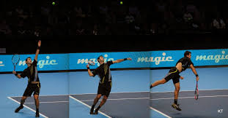
TENNIS ELBOW & PHYSICAL THERAPY
Bùi Kim Hằng
REHABILITATION DEPARTMENT
HOSPITAL FOR TRAUMATOLOGY AND ORTHOPAEDICS

Slide 2
OBJECTIVES
to extract the basic principles of biomechanics and anatomic structures related to Tennis Elbow
to choose the physical therapy methods
to establish the physical therapy programs in treatment and prevention

Slide 3
CONTENT
TENNIS ELBOW AND THE RELATED STRUCTURES
BASIC BIOMECHANIC PRINCIPLES IN TENNIS ELBOW CONDITION
TREATMENT
PHYSICAL THERAPY
REFERENCES

Slide 4
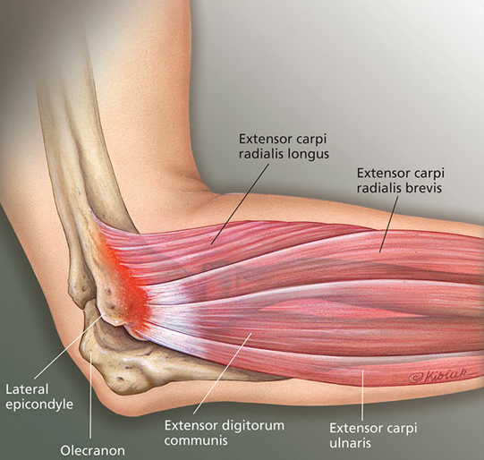
TENNIS ELBOW & RELATED STRUCTURES
I.1 DEFINITION:
Tennis elbow/Lateral epicondylitis/ Lateral tennis elbow/ Lateral stress syndrome):
overuse or repetitive stress syndrome
pain & degenerative lesion/inflammation of wrist extensor tendons originated from lateral humeral epicondyle

Slide 5
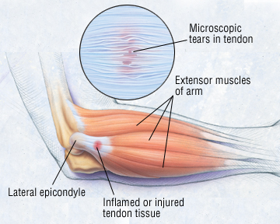
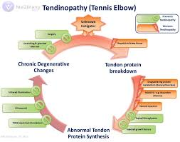
I. TENNIS ELBOW & RELATED STRUCTURES
I.2 PATHOLOGY:
angiofibroblastic hyperplasia
microscopic tearing & degeneration in tendon structure at musculotendinous/tenoperiosteal junction
granulation tissue formation within nerve ends→ pain
immature granulation tissue→ tendinous nonunion

Slide 6
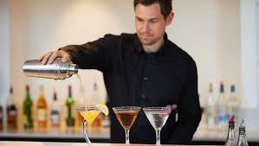
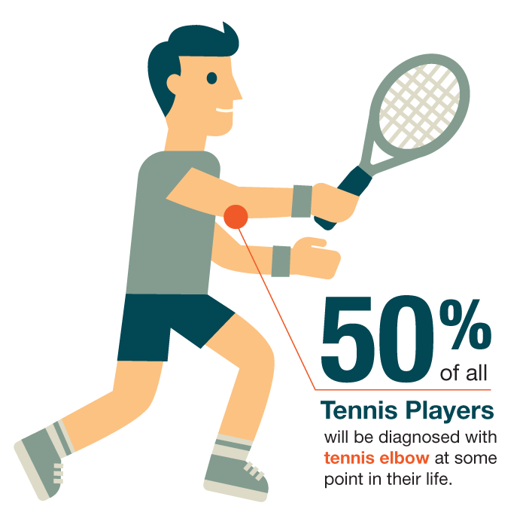
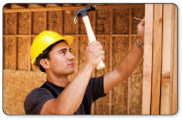
I. TENNIS ELBOW & RELATED STRUCTURES
I.3 FREQUENCY:
1 – 3%, female = male, ages of 30 – 55, dominant arm primarily involved
10 – 50% of all tennis players

Slide 7
I. TENNIS ELBOW & RELATED STRUCTURES
I.4 CAUSES: sometimes unknown, but most of cases result from:
overuse with excessive repetitive & vigorous elbow motions in overhead sports (tennis, handball, baseball…), or related to profession (heavy lift worker, cook, bartender, computer programmer…)
improper skill
unappropriate instruments (racquet with small handle, high string tension, too heavy... or low quality ball…)
Weakness of shoulder girdle and arm muscles

Slide 8
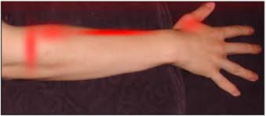
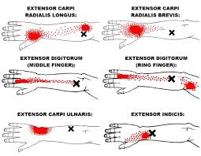
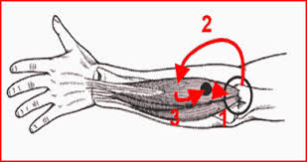
I. TENNIS ELBOW & RELATED STRUCTURES
I.5 SYMPTOMS: pain along lateral epicondyle results in daily activity difficulties (hand shaking, doorknob torquing, item holding…) and grip strength decreased

Slide 9
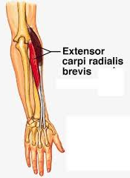
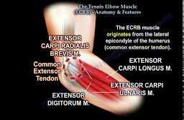
I. TENNIS ELBOW & RELATED STRUCTURES
I.6 THE RELATED STRUCTURES:
I.6.1. Muscles:
Extensor Carpi Radialis Brevis (ECRB): most vulnerable due to:
+ anatomic position: its undersurface rubbed against lateral edge of capitulum during elbow motions
+ coordinated motion: ECRL muscle squeezes the ECRB against the bone while elbow extended
+ function: wrist stabilizer while elbow extended/ excessively lengthened with elbow extended, forearm pronated and wrist in palmar flexion and ulnar inclination

Slide 10
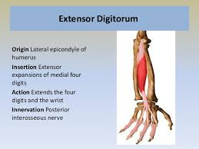
I. TENNIS ELBOW & RELATED STRUCTURES
I.6 THE RELATED STRUCTURES:
I.6.1. Muscles:
Extensor Carpi Radialis Longus (ECRL)
Extensor Digitorum Communis (EDC) involved in 1/3 of cases (at the third digit insertion originated from lateral epicondyle)
Extensor Carpi Ulnaris (ECU)

Slide 11
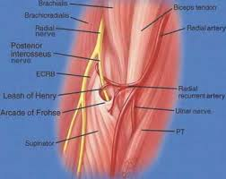
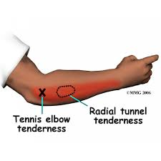
I. TENNIS ELBOW & RELATED STRUCTURES
I.6 THE RELATED STRUCTURES:
I.6.2 Nerve: Posterior Interosseous Nerve (PIN)

Slide 12
II. BASIC BIOMECHANIC PRINCIPLES IN TENNIS ELBOW CONDITION
II.1 Leverage principles:
class 1: Fulcrum in the middle → mechanical advantage >/</= 1
class 2: Resistance in the middle → mechanical advantage > 1 with small displacement
class 3: Effort in the middle → mechanical advantage < 1, larger displacement & speed

Slide 13
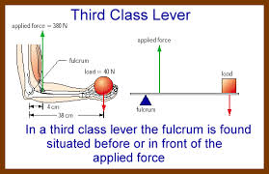
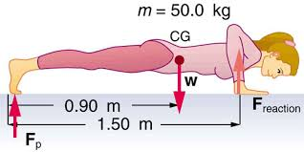
II. BASIC BIOMECHANIC PRINCIPLES IN TENNIS ELBOW CONDITION
☞ Converting the 3rd class lever system of elbow (flexion, concentric contraction) into 2nd class lever system (extension, eccentric contraction) → improve muscle strength & decrease pain

Slide 14
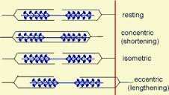
II. BASIC BIOMECHANIC PRINCIPLES IN TENNIS ELBOW CONDITION
II.2 Muscle contraction types:
Isometric contraction
Isotonic contraction
- concentric contraction
- eccentric contraction

Slide 15
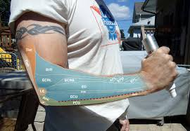
II. BASIC BIOMECHANIC PRINCIPLES IN TENNIS ELBOW CONDITION
II.3 Eccentric contraction:
lengthens musculotendinous complex → results in structural remodeling with hypertrophy & increases tendinous tensile strength
simultaneously affects the agonist & antagonist muscles → facilitates neuromuscular transmission
☞ Therapeutic Eccentric Exercises (TEE) effectively used in tendinopathy management

Slide 16
TREATMENT
III.1 CONSERVATIVE TREATMENT: stages 1, 2
PRICEMM
Sport instrument modification (racquet, ball…)
Exercises

Slide 17
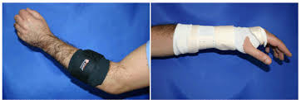
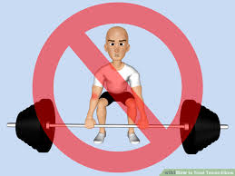
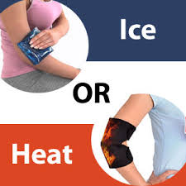
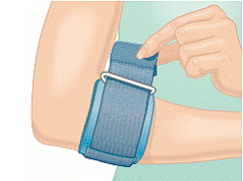
TREATMENT
PRICEMM
P (Protection): brace/ splint → disperse stressful gripping forces at tendon origins
R (Rest): decreasing activities
I (Ice): 10 – 15 min/4 – 6 times/ day
C (Compression): bracing below the elbow
E (Elevation): if swelling

Slide 18
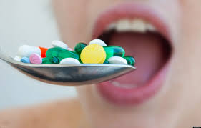
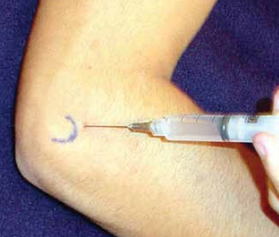
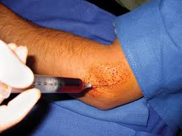
TREATMENT
PRICEMM
M (Medications):
+ NSAIDs
+ Steroid injection
+ Placelet-Rich Plasma injection

Slide 19
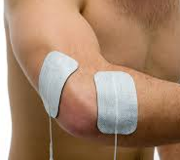
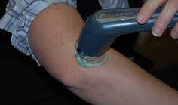
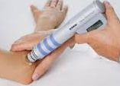
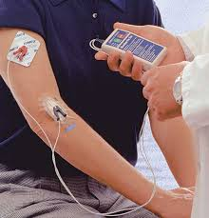
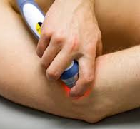
TREATMENT
PRICEMM
M (Modalities):
electrotherapy
sound wave (US, shock wave)
short wave
iontophoresis
light wave (IR, LASER…)

Slide 20
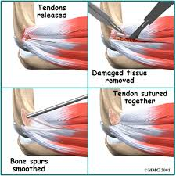
TREATMENT
III.2 SURGERY: 2%
stage 3, 4
↓ to change stressful force of tendon at periosteum & local vascularity: injured tissue excision, deposited calcium taking, tendon origin relief from lateral epicondyle, tendon reinsertion…
prolonged pain (>1 year), pain at rest, patient requires high level activities (sports, competition…)
conservative therapy failed after > 6 months

Slide 21
PHYSICAL THERAPY
IV.1 SUBJECTIVE ASSESSMENT:
pain: time, painful points, severity, irritability, nature, improving/aggravating factors?
strange feeling, poping in elbow while moving?
former treatment?

Slide 22
PHYSICAL THERAPY
IV.2 OBJECTIVE ASSESSEMENT:
pain, tenderness, swelling over radial head?
valgus/ varus/ cubital recurvatum?
pain with resistance in wrist dorsiflexion, finger extension and radial inclination?
pain while passively stretching wrist extensor muscles ?
atrophy/ weakness of forearm extensors?
muscular strength: biceps, triceps, brachioradialis, supinators, ECRL/ECRB, EDC…
decreased PROM of wrist flexion?
decreased ROM of flexion, extension, pronation, supination?

Slide 23
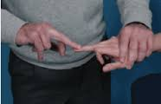
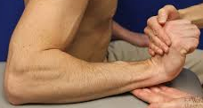
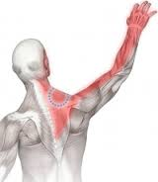
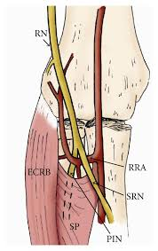
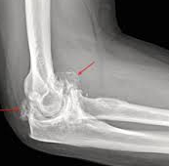
PHYSICAL THERAPY
IV.2 OBJECTIVE ASSESSEMENT:
tests: Mill, Maudsley, Cozen, chair lift test?
cervical radiculopathy (C6, C7)?
PIN syndrome: 5% of cases
posterolateral instability (after ligamentous injury, radial head inflammation/ degeneration, elbow luxation, radial head excision, coronoid process fracture…)?

Slide 24
PHYSICAL THERAPY
IV.3 OBJECTIVES:
reduction of pain, swelling and facilitation of tissue repair process
restoration of ROM and muscle length
strengthening muscles
patient education: retraining, avoiding overuse and injury/ recurrence

Slide 25
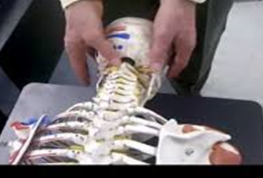
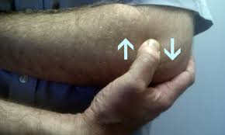
PHYSICAL THERAPY
IV.4 PLANNING:
Reduce pain & swelling:
ice/ heat (depends on acute/ chronic stage)
splint/ brace to support/ protect in daily activities
electrotherapy: medium-frequency currents (TENS, interferential current…), sound waves (US, shock wave), short waves, iontophoresis, light waves (IR, LASER…) → improves pain & local vascularity → facilitates motions & tendon healing process
deep transverse friction (DTF)→ pain relief & increasing soft tissue mobility

Slide 26
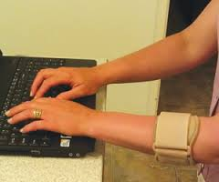
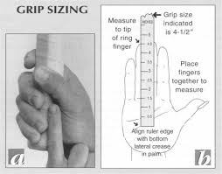
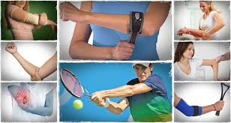
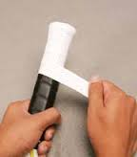
PHYSICAL THERAPY
IV.4 PLANNING:
Correct body mechanism: (sports)
force transfer with body weight
elbow support (if needed)
modification of racket handle & type…

Slide 27
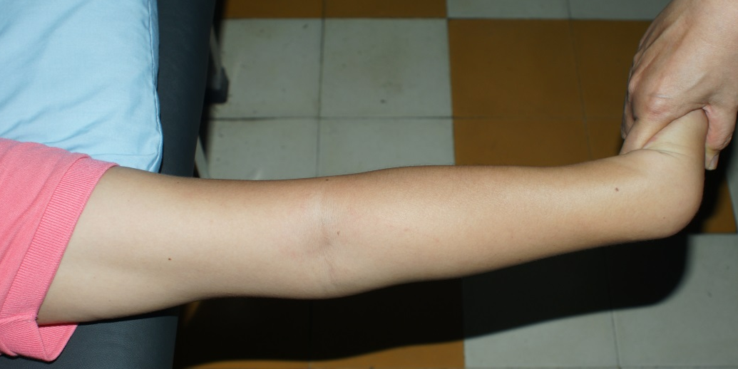
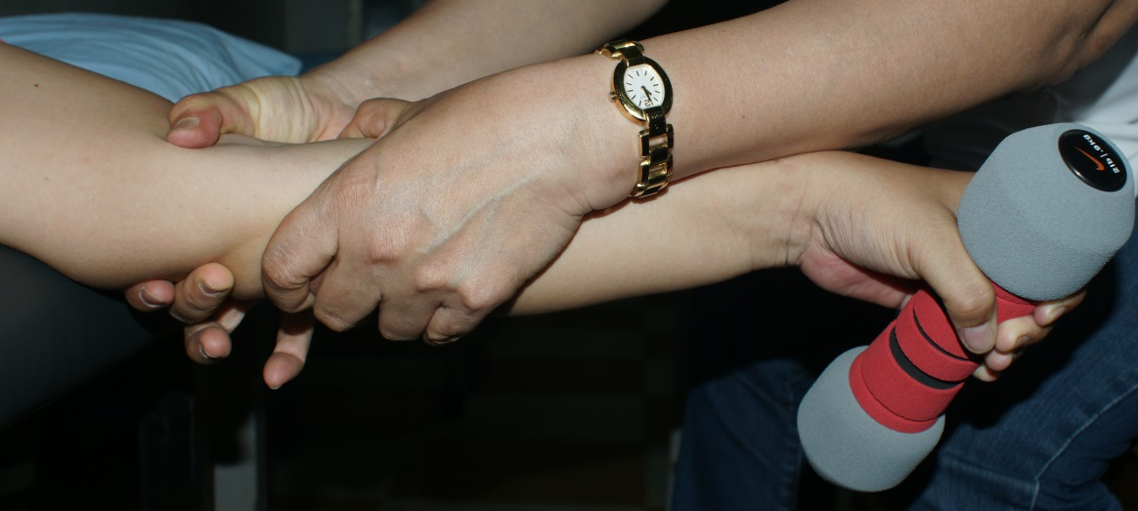
PHYSICAL THERAPY
IV.4 PLANNING:
Exercise to increase ROM:
passively stretching : after interventions for pain relief
exercises at the end of ROM
DTF/ joint mobilization
Mobilization With Movement (MWM) → relieve pain & adherent scar

Slide 28
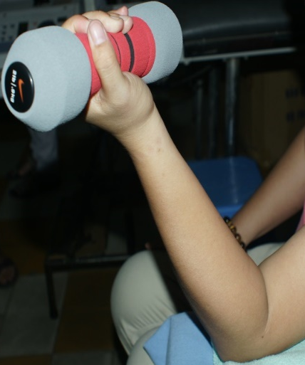
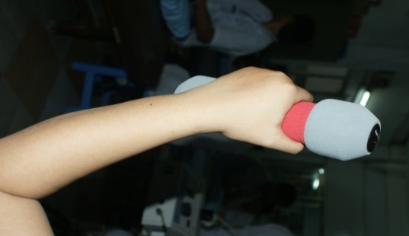
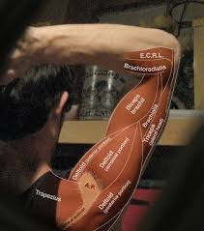
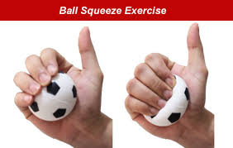
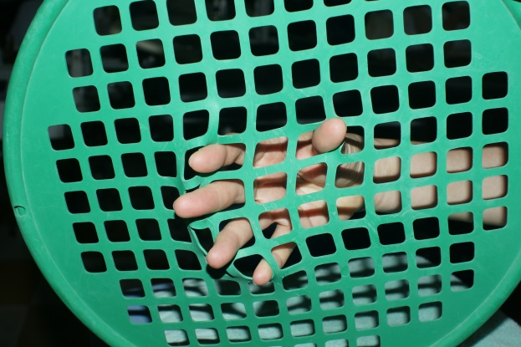
PHYSICAL THERAPY
IV.4 PLANNING:
Exercise to strengthen muscles: after inflammation stage (> 2 weeks without pain)
strengthening the flexor, extensor of wrist & fingers, biceps, triceps, brachioradialis, rotator cuff muscles
AROM & isometric exercises

Slide 29
PHYSICAL THERAPY
IV.4 PLANNING:
Exercise to strengthen muscles:
eccentric exercises with gradually increased resistance
MWM

Slide 30
PHYSICAL THERAPY
IV.4 PLANNING:
Exercise to strengthen muscles:
improving the strength, endurance, velocity of movement
closed kinetic chain exercises
movements for sport retraining
plyometric exersises

Slide 31
PHYSICAL THERAPY
IV.4 PLANNING:
Prevent re-injury: patient education
eliminate risk factors (gripping with pronation…)
modify daily activities in work & sports: posture, instruments…
combine motions of both upper extremities (↓ forces while elbow extended, pronation & wrist extension…)

Slide 32
PHYSICAL THERAPY
IV.4 PLANNING:
Prevent re-injury:

Slide 33
PHYSICAL THERAPY
IV.5 FOLLOW-UP & ASSESSMENT:
visual analog scale (VAS)  subjective pain
disability of arm, shoulder & hand questionnaire (DASH questionnaire)  subjective disability
pain-free grip strength

Slide 34
REFERENCES
Amrish O. Chourasia, PhD – Kevin A. Buhr, PhD – David P. Rabago, MD – Richard Kijowski, MD – Kenneth S. Lee, MD – Michael P. Ryan, PhD – Jessica M. Grettie-Belling, BS – Mary E. Sesto, PT, PhD Relationships between Biomechanics, Tendon Pathology, and Function in Individuals with Lateral Epicondylosis – J Orthop Sports Phys Ther. 2013 June; 43(6): 368-378. doi: 10.2519/jopt.2013.4411
Bộ môn Giải phẫu học ĐHYD Tp. HCM Bài giảng giải phẫu học tập 1 – Nhà xuất bản y học chi nhánh Tp HCM 2004; p 86-87, p 90-102
Brett L. Woodley – Richard J. Newsham-West – G. David Baxter Chronic tendinopathy: effectiveness of eccentric exercise – Br J Sports Med. 2007 Apr; 41(4): 188-198. doi: 10.1136/bjsm.2006.029769
Carolyn Kisner, PT, MS – Lynn Allen Colby, PT, MS THERAPEUTIC EXERCISE Foundations and Techniques – F. A. Davis Company 2007; p 65-94, p 147-223
Fairbank S. M. – Corlett R.J. The role of the extensor digitorum communis muscle in lateral epicondylitis – J Hand Surg 2002 Oct, 27(5): 405-9
Frederick M. Smith, MD Surgery of the elbow – W. B. Saunders Company 1972; p 274-277

Slide 35
REFERENCES
Garg R. – Adamson G. J. – Dawson P.A. – Shankwiler J. A. – Pink M. M. A prospective randomized study comparing a forearm strap brace versus a wrist splint for the treatment of lateral epicondylitis – J. Shoulder Elbow Surg. 2010 Jun; 19(4): 508-12. doi: 10.1016/j.jse.2009.12.015. Epub 2010 Apr 2
Gerald R. Williams, JR, MD – Ken Yamaguchi, MD – Matthew L. Ramsey, MD – Leesa M. Galatz, MD Shoulder and Elbow arthroplasty – Lippincott Williams & Wilkins 2005; p 279-286, p 300-305
Gosen T. – Peerbooms J. C. – Van Laar W. – Den Oudsten B. L. Ongoing positive effect of Platelet-Rich Plasma versus corticosteroid injection in lateral epicondylitis: A double-blind randomized controlled trial with 2-year follow-up – Am J Sport Med. 2011 Jun; 39(6): 1200-8. doi: 10.1177/0363546510397173. Epub 2011 Mar 21
Jean-Louis Croisier – Marguerite Foidart-Dessalle – Benedicte Forthhome An isokinetic eccentric programme for the management of chronic lateral epicondylar tendinopathy – Br J Sports Med. 2007 Apr; 41(4): 269-275
Robert E. Bunata, MD – David S. Brown, MD – Roderick Capelo, MD Anatomic factors related to the cause of tennis elbow – J Bone Joint Surg Am. 2007; 89: 1955-63. doi: 10.2016/JBJS.F.00727

Slide 36
REFERENCES
R. Kanagasuntheram, MBBS, PhD, AM, FI Biol, DSc – P. Sivanandasingham, MBBS, PhD – A. Krishnamurti, B Sc, MBBS, FAZ, PhD, MI Biol, FAMS ANATOMY Regional, Functional and Clinical – B G Pubblishing 1987; p 83-89, p 107-115
Timothy F. Tyler, MSPT, ATC – Gregory C. Thomas, DPT, CSCS – Stephen J. Nicholas, MD – Malachy P. McHugh, PhD Addition of isolated wrist extensor eccentric exercise to standard treatment for chronic lateral epicondylosis: A prospective randomized trial – J Shoulder Elbow Surg (2010) 19, 917-922. doi: 10.1016/j.jse.2010.04.041
Todd S. Ellenbecker, DPT, MS, SCS, OCS, CSCS – Robert Nirschl, MD – Per Renstrom, MD, PhD Current concepts in examination and treatment of Elbow Tendon injury – Sports Health. 2013 Mar; 5(2): 186-194
www.exrx.net.kinesiology – Mechanics in exercise: Levers
www.fgc.edu>uploads>2011/12 - Biomechanics
www.study.com>academy> - How muscle levers affect muscle efficiency

Slide 37
MANY THANKS
FOR YOUR KIND ATTENTION

