Slide 1
THR designs and options for complex hips
Mr. Glenn Boyce MBBS Dip Anat FRACS

Slide 2
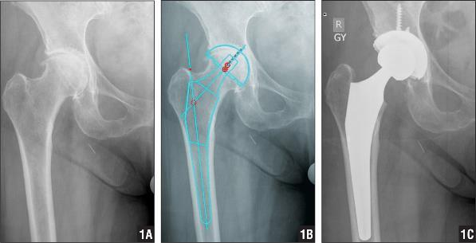
Femur uncemented options
Proximal metaphyseal fit
- 2 neck angles (127⁰ or 132⁰⁾
⁻ Offset increases with body size (28- 53mm)
Must template to see if the uncemented stem fits

Slide 3
Will not work in all cases
Must template to see if the uncemented stem fits

Slide 4
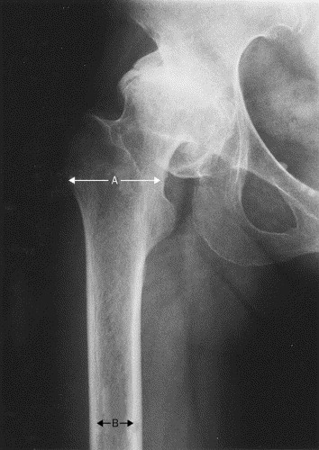
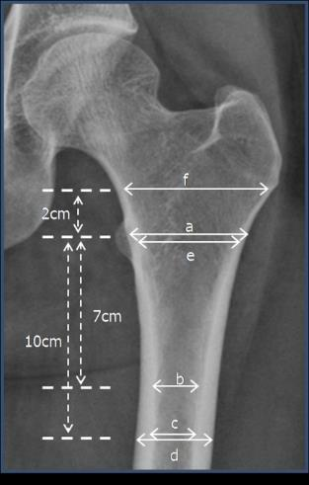
Difficult distal stem fixation
Canal flare
A/B
Wide less than 3
Normal 3- 5
Higher failure rate uncemented
A
B

Slide 5
Cement gives more options!

Slide 6
More freedom to match centre of rotation

Slide 7
Plus you can adjust anteversion

Slide 8
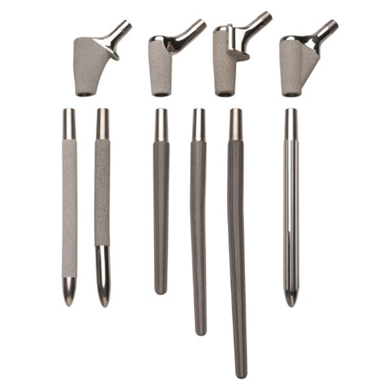
Modular uncemented options
diaphyseal + metaphyseal fit
Choices in distal stem morphology

Slide 9
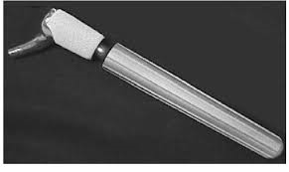
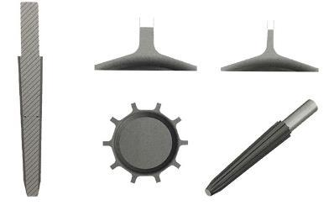
Taper + flutes improved distal stability
Taper → immediate axial stability.
Higher taper angle (>5 degrees) improves resistance to subsidence
50% cases have mild subsidence within 3 years (> 1.5 mm)
5-10% Significant subsidence >3 years (> 5mm)
Flutes provide immediate rotational stability. (Thinner flutes increased torque resistance)

Slide 10
Stem requirements
Extensively porous coated stem
Bi-cortical contact MUST be 2 cortical widths
finish ETO above isthmus
Power reaming distal
Straight stem creates 3 point fixation

Slide 11
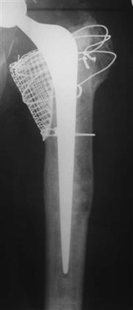
Revision- Uncemented long stem with impaction grafting
Option for elderly low demand patients with poor bone stock
BUT
Demanding
Recreate tube and stabilise
Remodeling of the endosteum around 6 weeks leads to canal widening
New tumour prosthesis easier to use for low demand patients

Slide 12
Support options for bone grafting

Slide 13
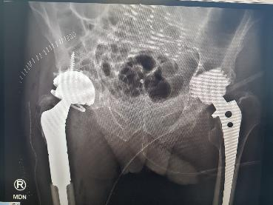
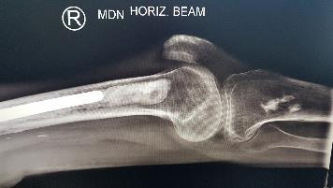
Proximal femoral replacement

Slide 14
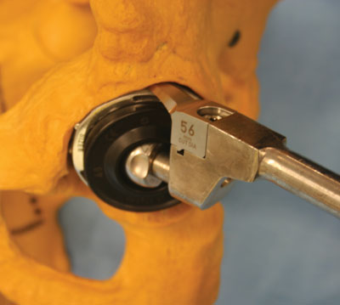
Primary or revision
intact AP rim ?

Slide 15
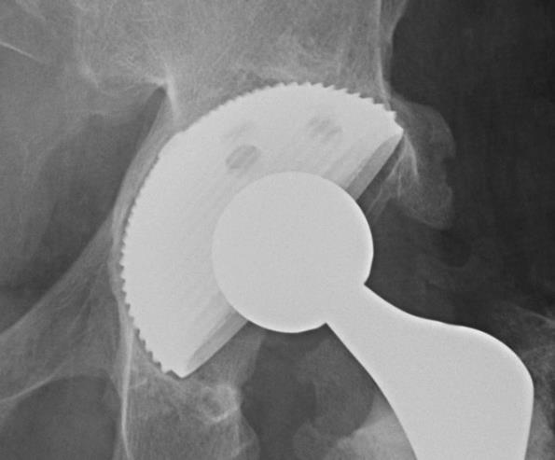
Jumbo Cup
10-15 year survival 85-95%
Intact AP rim and pelvic continuity
> 50% bony contact
Typically add screws

Slide 16
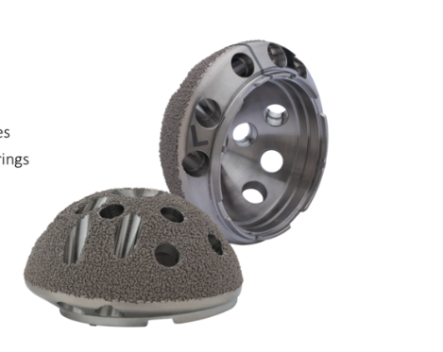
New versions of jumbo cup
Cup placement should be inferior and medial
lowers joint reactive forces
Decreased impingement on prominent anterior cup

Slide 17
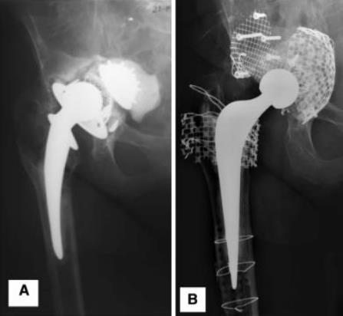
Grafting
Small cavitary lesions
→ Cancellous bone graft
Possible for massive defects with mesh alone, but 20% revision rate by 10 years

Slide 18
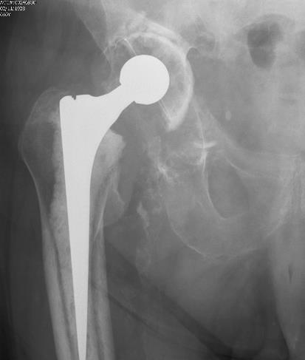
Addition of mesh and cage
Decreased need for cortical graft and amount of cancellous graft
Improved ability to restore centre of rotation

Slide 19
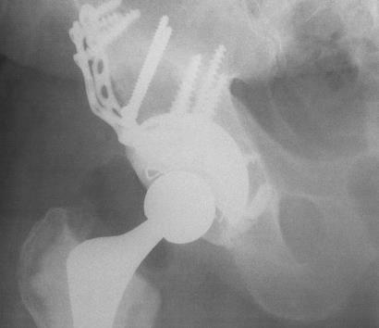
Cortical augments
Cortical grafts weaken and resorb at 3-5 years
Uncemented cups will not bond to graft

Slide 20
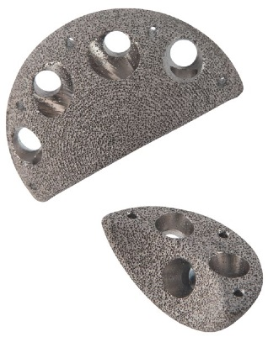
Metal Augments
Improved long term stability Vs cortical graft

Slide 21
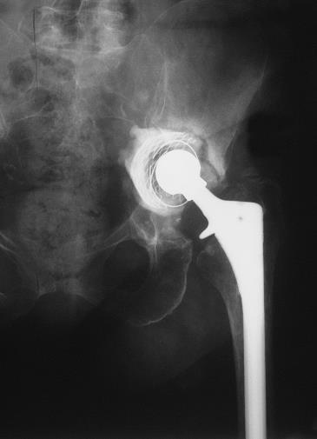
Continuity must be restored

Slide 22
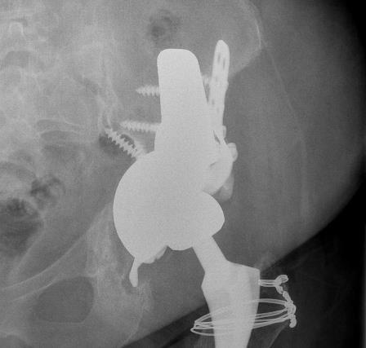
50% plus failure rate with graft and plate
Better option

Slide 23
Stabilise pelvis and restore bone stock
Antiprotrusio cages with bone ingrowth potential

Slide 24
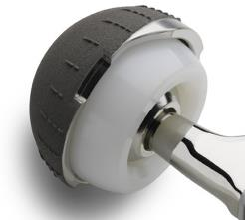
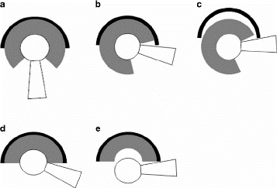
Prevent dislocation?
High risk of dislocation
Semi constrained or constrained liner
Tips: Don’t increase the anteversion of the acetabular component compared to the native acetabulum!!! These implants lever out from neck impingement on the prosthesis

Slide 25
Thank you

